Slide 1
Interview Wizard Design
August, 2013

Slide 2
Contract Interviews: Rationale
We've seen how a Standard User can use an interview to create a contract, and the benefits of that approach.
Customers often think they can create a fully standard contract, but it's rare that absolutely no tailoring is needed. Hence, an interview is a great way to perform the tailoring easily.
We'll now look at how to design an Interview.
The key reference for this feature is the Interview Wizard User Guide

Slide 3


What is an Interview?
Interviews are used to guide users when creating contracts and entering contract values.
  Asks the user a question (for example, “What is the estimated global value?”)
  Provides an exit action based on the user’s response to a question
  Provides instructions for guiding the user on what selection to make
Interviews can:
  Enter Term values
  Set other values (Parties, effective dates, Lines)
  Set relationships and attachments
  Place or replace clauses
  Create a Contract
Interviews cannot:
  Create more than one contract at once
  Perform workflow (such as review request)
  Perform any administrative tasks
  Create anything past first draft of a contract instance
The end result of an interview is ALWAYS a contract.

Slide 4
How is an Interview Created?
Only users with the appropriate security access have the ability to design and create interviews.
The Interview sample design process that is followed includes identifying these:
  Questions that need to be asked to the user (and the format it should be presented).
  Default answers, if any, for the above questions
  List of Terms to be filled in by the interview as a result of answers to the questions
  Conditions for including and excluding clauses
  Any questions that are required in order to proceed to the next step
Contract Authors have permission for basic interview functionality such as starting an interview from an existing Interview Wizard in order to create a contract.

Slide 5
Interview Components
Interview: an interactive series of questions that results in creation of a contract instance
Input Control: An input field in a Step
Step: A question within an interview. It captures the user's response(s) through input controls(s). It also may have:
  Expressions and conditions that can cause progression to another step, the setting of a property, etc.
  Exit Actions (Set Term, Insert/Replace/Delete Clause, Set Effective Start Date, etc.)
Step Design: A definition of a step that is reusable across multiple Interview Designs. (Within the Interview Designer, these are called Interview Elements.) The Exit Actions are part of the Step Design, specifying what happens when the user clicks Next or Done. The Navigation Actions (see below) tie steps together and are at the Interview Design level.
Interview Design: A reusable definition of an interview. It references a series of step designs in a specific order or defined to display steps conditionally based on previous responses. The interaction between steps is defined by means of Navigation Actions, which are either explicit or implied by the sequence of step designs.
  The Navigation Actions are Create Contract, Go To Step, Set Value, Set Line Field, and Set Template.

Slide 6
Results of an Interview
At the completion of an interview execution, the following result:
  An “authored or filed” contract (*)
    A Filed contract created from an interview must use a contract template
  Contract property settings
  Terms, Lines, and Clauses in the contract.
    These must originate from existing objects; i.e., the interview cannot create them
    Note, however, that Lines could have been created through a Line Definition with the auto-populate option (new in V10.0.1). In this case, there will be a Line for each of the contract's internal-external Party pairs that was not already represented by a Line.
(*) The Interview Wizard Guide says you can only create “authored and filed” contracts through an interview. Also, the “Edit Navigation Action” dialog in the Interview Designer lets you choose a Language Source of only “Contract Template” or “Attached File”. So you can't use an interview to create a contract with a type of Received (as seen at the bottom of the contract's Header tab), but after creating a Filed contract in an interview you can attach a Word document to the contract, and thus come close to the meaning of a Received contract.

Slide 7
Wizard Design Guidelines
Since an interview design is simply a faster and more accurate way to create contracts, designing effective ones is essentially a matter of understanding what the users need to do (imagine there are no wizards), and then mapping those actions to the ECM application.
Guidelines:
  Start with the big picture: understand what the customer users are trying to perform, in terms of tasks. Be sure to design the interview to respond to user inputs, not force the user to respond to the system.
  Understand and optimize the business process
  Understand the Emptoris Contract Management implementation, particularly all of the objects related to content creation. It follows that wizard design can only be done after or very near the end of the implementation.
  As you develop your Wizard Design, it is suggested that you document the fields (Input Controls) and Steps in either the Interview Master (from the informal Design Masters suite) or a product such as Microsoft Visio.

Slide 8
A Simple Interview Design
Here are the possible steps in a very simple interview design.
  Step 1: Ask which type of contract is needed: Master Services Agreement (MSA) or Purchase Agreement (PA). Also accept effective start date and other Term values common to both types of contracts. Depending on the contract type, go to step 2 or 3 [navigation action].
  Step 2 (MSA). Ask a question prompting for Term values specific to an MSA contract, and set those values. Go to step 4.
  Step 3 (PA). Ask whether Services are to be included; if so, insert the corresponding clause. Go to step 4.
  Step 4. Set the contract template as appropriate for MSA or PA. Create the contract.
  (Note: Step 1 could be split into multiple steps. In this example, the “question” could be “Choose the contract type and give values for the indicated terms.”. Each step can have only one question.)

Slide 9
Designing Effective Interviews
(See the Interview Wizard Guide for details on these)
Design Task-Oriented Interviews
Define Activities from the User Perspective
Include Generic Management Activities
Provide Interim Action Choices
Use Agenda Steps to Indicate Progress
Summarize Inputs before Concluding

Slide 10
Designing Effective Steps
(See the Interview Wizard Guide for details on these)
Focus each Step on One Objective
Ask Questions
Communicate through Labels
Group Related Input Controls
Avoid Complex Steps
Place Interdependent Controls in Separate Steps
Preview Interview Design
Do Not Show Irrelevant Elements
Use Done to Indicate Completion

Slide 11
Implementing the Wizard Design
Before starting, virtually the entire implementation should be compete, so that all of the key objects (especially Terms, and probably Contract Templates) are already in place
It is suggested that you start by adding the Step Designs to the system.
Plan your Interview Designs carefully, because they cannot be deleted (easily). The best easy way to come close to deleting them is to change their Effective End Dates to a past date, rendering them inactive. They will then not be usable for Run Interview, but they can be duplicated and edited. Inactive Interview designs will not appear in a search, except of all Interview Designs would not find them unless you put in the starting character of the name.
Limitations:
  When you create an Input Control, you don't get to choose its characteristics. E.g., a Date field always gets an accompanying Time field, even if you don't want the latter.
  No formatting changes are possible.
  When you choose a client, the first one added always gets the Primary role.
As of V10.0.1, HTML changes to interview pages are supported; documentation is limited

Slide 12
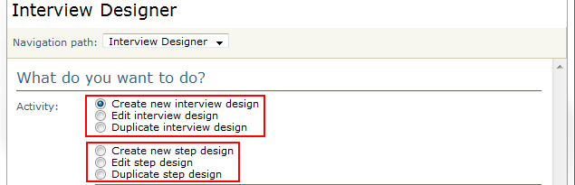
Implementing the Wizard Design, cont.
Wizards are designed at Administration > Standards > Interview Designer.
When you open the Interview Designer, the choices of interest are to work with (create, edit, or duplicate) either an interview design or a step design.
  It is strongly recommended not to duplicate interview designs, because if you create and edit a duplicate, you may not take into consideration system changes made since the original interview was created.
When you create a new interview design you are asked to:
  Identify the organization(s) (and thereby their child organizations) that can use it.
  Identify the individual(s) that can use it. If you don't name any, an individual must be a contact of the above organizations or child organizations to use it. Naming individuals does not change the effect of naming organizations as above.

Slide 13
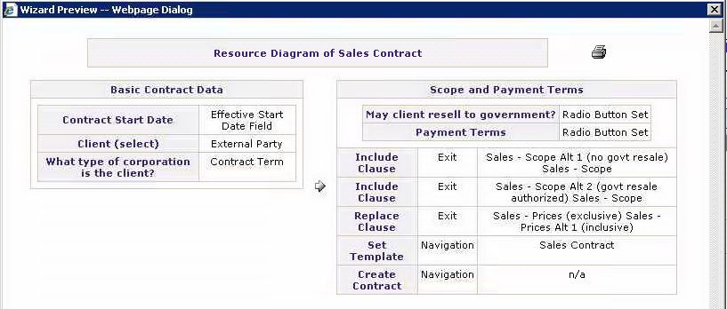
Implementing the Wizard Design, cont.
You can use the Navigation Path list to go back to a previous step, but when you go back that way, the subsequent steps are removed from the list.
Notice that designing an interview through the Wizard is itself done through an interview
Clicking the Preview button for an interview design gives a nicely readable summary of the design (especially for very simple ones as below). Each box represents a step design used in the interview.

Slide 14
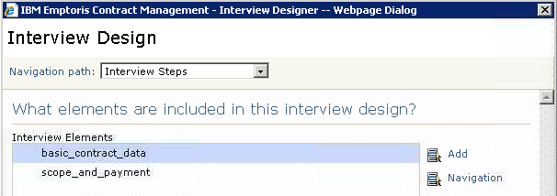
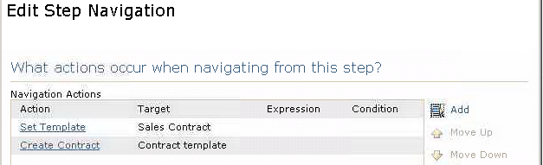
Implementing the Wizard Design, cont.
When editing an interview design, you are shown the current Interview Elements and can add more. These Interview Elements are actually “invocations” of step designs; i.e., steps.
  By selecting an Element and clicking Navigation, you can see the Navigation currently associated with it. In the case below, we have navigation actions to choose a template and create the contract. Note that “navigation” does not necessarily imply movement to another step.

Slide 15
Interview Design Exercise
We will now do an exercise involving duplicating and modifying an existing interview. Earlier it was recommended NOT to duplicate interview designs. But for learning ...
Log in as your assigned Instructor user (to ensure correct permissions for this exercise)
Administration > Standards > Interview Designer > Duplicate Interview Design > (Select an interview design to duplicate, such as Sales Contract). You are taken into the design wizard.
Give the design a Name and Title starting with your initials.
Click the Preview button to get a resource diagram of the existing design, noting the names of the Step Designs and what they do. You can plan your own change or follow the suggestion below. In either case you must find out things such as which Contract Template is used, and which Clause Templates it contains.
  We assume here that we will (1) unconditionally insert a clause as part of an existing step, get that working, then (2) add a new step design (with a question) that will optionally delete another clause. The first part will involve changing a step design used in the interview design.
Step through the interview design duplicate; no changes are needed. Save.

Slide 16
Interview Design Exercise, cont.
Now duplicate the step design you want to change, and name it with your initials. Go through the steps for it until you get to Exit Actions. This is where you add the insertion of a new clause. Click Add to add a new Exit Action, and choose “Insert Clause” as the Action Type.
Select the clause to be inserted, such as Witnesseth. Remember which clause you choose. If you choose a clause that is already in the Contract Template, it will not be added again. Don't specify a Target clause or Conditions. Save the step design.
Now go back and edit your interview design. Go through the steps until you reach the Interview Elements step. Add a new element which is your modified step design. You must then add navigation for that new element, using the same actions that the original step design had; without those, you will get to the end of the interview and no contract will be created. After saving that navigation, delete the element for the original step design. Save the interview design.
Test your change by running an interview with the new design. Make sure it creates a contract, then confirm that the new clause is in the contract (assuming you didn't specify a Target clause, the new clause should be at the end). Take note of another clause name, for use in the next step.

Slide 17
Interview Design Exercise, cont.
We'll now do the second step of the exercise: adding a step with a question (Input Control) to drive the optional deletion of a clause from the contract template when creating the contract. (The contract template itself is not affected.)
For this step, the easiest approach is to duplicate an existing step design. We will assume this approach. You can also try creating a step design from scratch, in which case you may want to study some existing step designs.
Duplicate an existing step design, such as Scope and Payments (as used by the Sales Contract interview design).
Edit the design. In naming it, use your initials, and watch out for the Name value (lower case, underscores, digits only) and Name and Label lengths (30 and 50, respectively, and the entry fields do not restrict the length: you get an error later if a value is too long).
Proceed through the Wizard to the Input Controls step. Delete any existing controls and add a new one with a type of Radio Button Set (and Yes/No values), asking if the Sales Definitions (for example) should be included.

Slide 18
Interview Design Exercise, cont.
Continue to the Exit Actions step. Delete any existing exit actions except for one (preferably an Insert Clause or Replace Clause action). Edit the remaining action: Change the action to Delete Clause, choose the clause to be deleted (such as “Sales – Definitions”, and add a condition such as:
    GETVALUE("bw_step_to_delete_sales_defns > include_sales_definitions") == "No"
    (this function usage has the form “GETVALUE(step_name > input_control_name)”)
We now edit the interview design (the same one as before) to incorporate the new step.
Step through the wizard without making any changes until the Interview Steps step. Add your new step design and move it to precede the final step (which creates the contract). No navigation is needed for the step design in this interview. Step to the end of the Wizard. Do a Preview and make sure everything looks OK, then click Done.
Test your latest changes by running two interviews with the new design, then verify the language of the created contracts. In the first interview, check the Yes button to include Sales Definitions, which should not delete a clause. In the second, do everything the same again, except check the No button, which should delete a clause.
See next slide for an illustration of the changed contract.

Slide 19
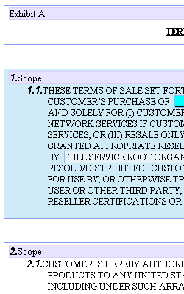
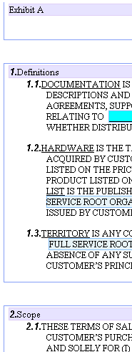
Interview Design Exercise, cont.
On the left is the created contract without Sales Definitions deleted. On the right, with that clause deleted. (Notice how the proper definition of styles in the Format Template has resulted in the correct automatic renumbering of the list items: the original “2.Scope” became “1.Scope”.)

Slide 20

Questions?

